Slide 1
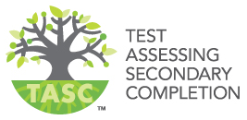
New York State’s 2018 High School Equivalency Test

Slide 2
NYS has a new, subsidized test leading to a NYS High School Equivalency Diploma
TASC replaces GED as the free assessment leading to a NYS High School Equivalency diploma
Website: www.TASCTEST.com

Slide 3
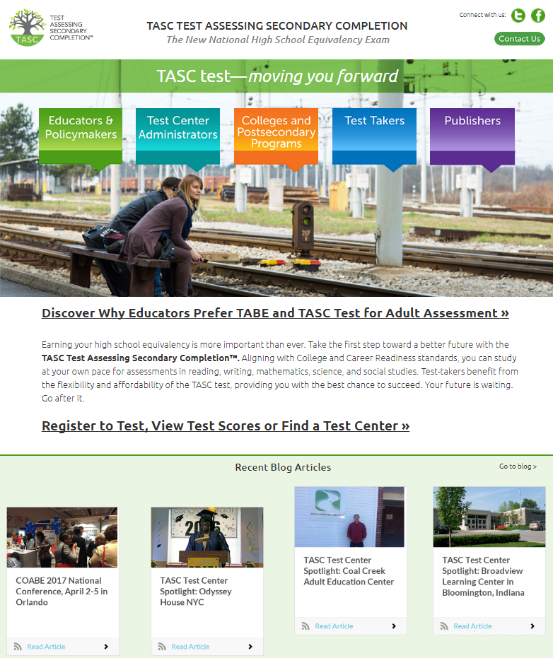

Slide 4
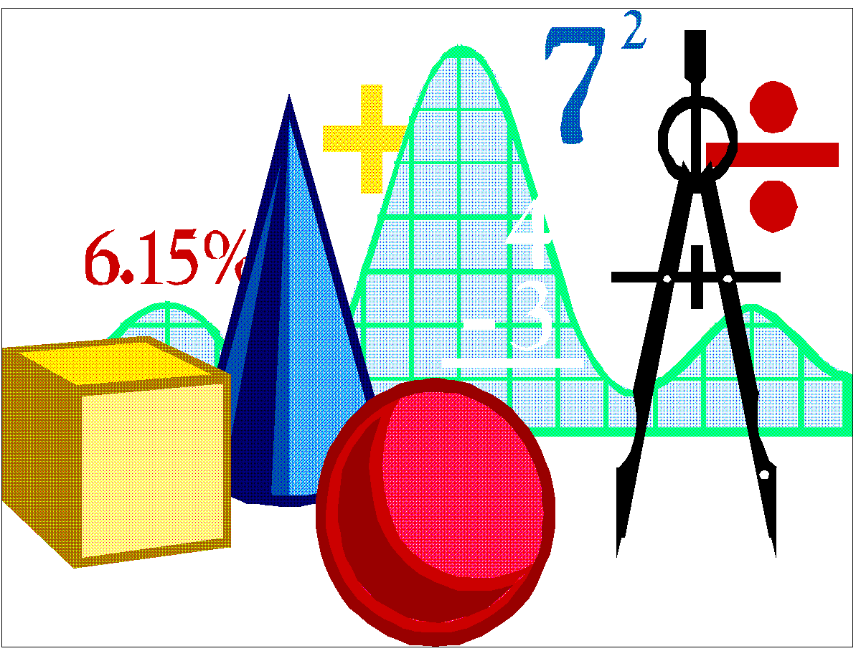
Five Subtest make up the entire TASC Exam

Slide 5
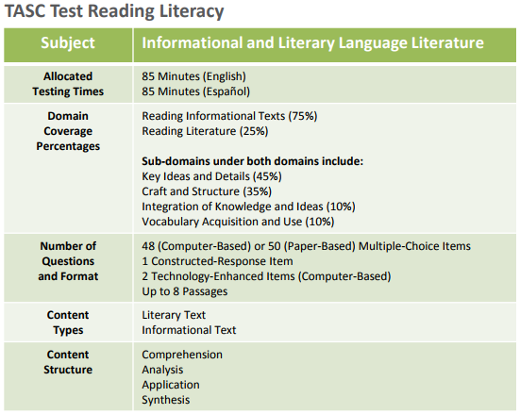
Notes:
This slide: CCSS item rubric
‹#›

Slide 6
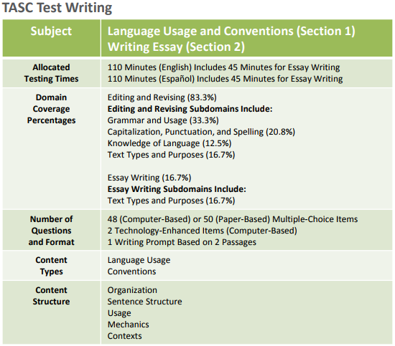
Notes:
This slide: CCSS item rubric
‹#›

Slide 7
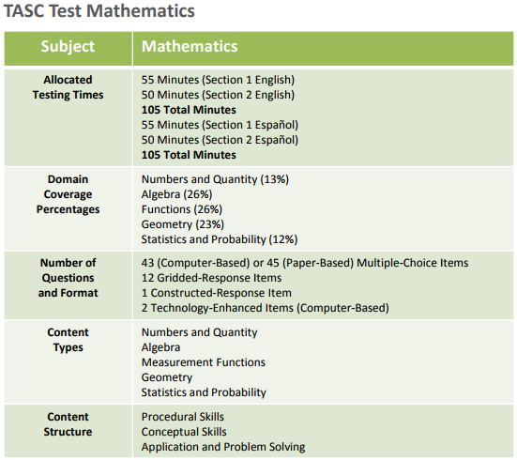

Slide 8
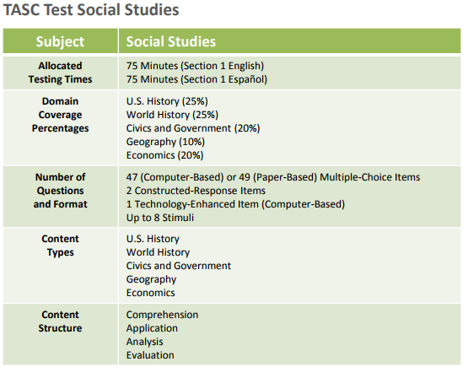

Slide 9
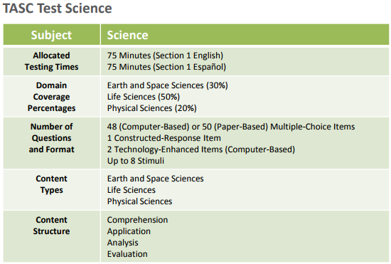

Slide 10
Can I take the TASC tests online?
Although there are online programs for TASC preparation, there is NO online TASC testing!
You must take the TASC test at an authorized test center.

Slide 11
How much does the TASC cost?
There is NO FEE for you to take the TASC test in New York State.
The New York State Education Department is the ONLY organization that may issue New York State High School Equivalency diplomas.

Slide 12
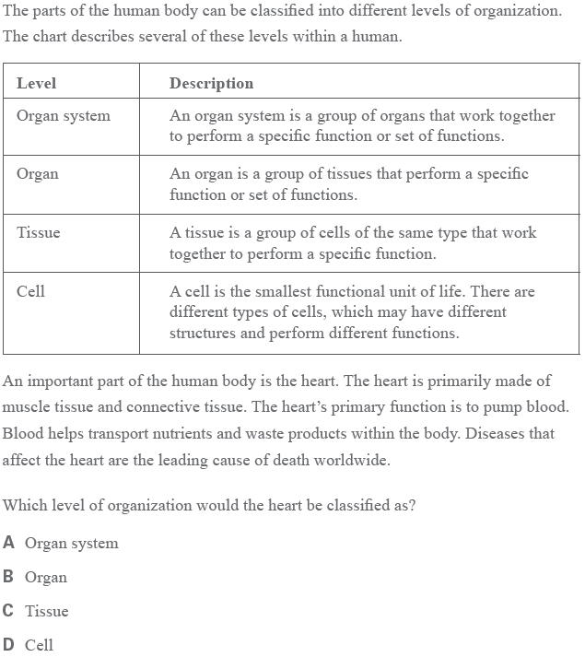
TASC Sample Item, Science

Slide 13
TASC Sample Item, Mathematics

Slide 14
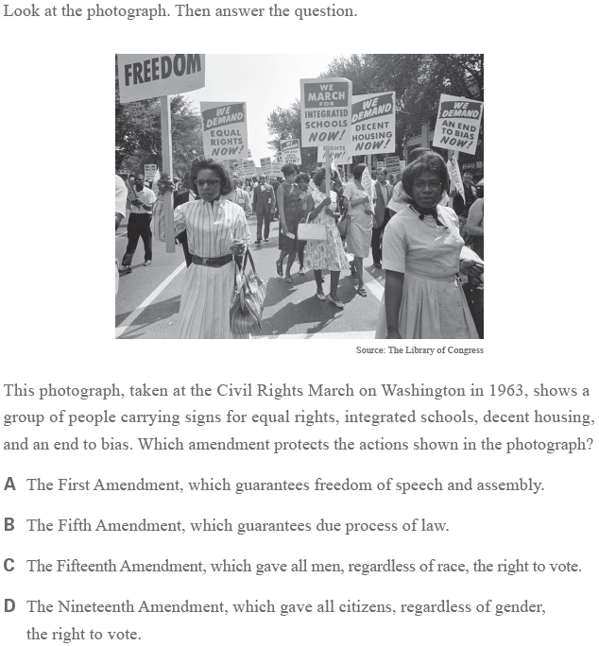
TASC Sample Item, Social Studies

Slide 15
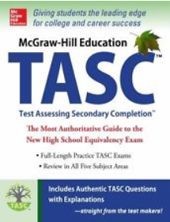
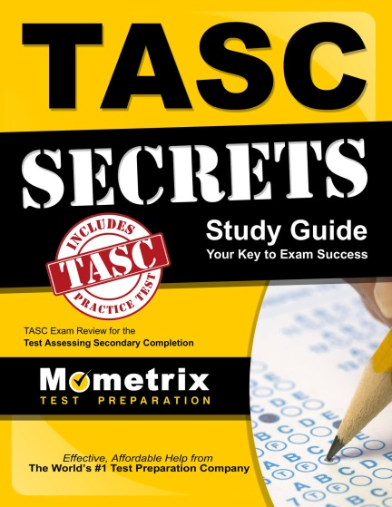
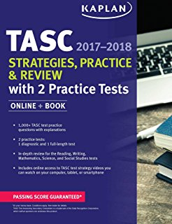
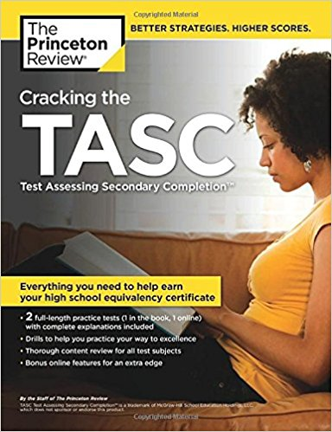
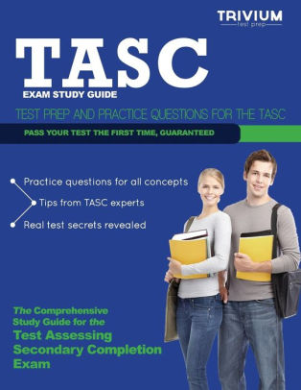
Study Materials you can Purchase

Slide 16
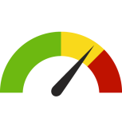
Scoring
Scores range from 300-900 for each test
500 is considered a passing score

Slide 17
What if I already have scores from the GED Exam? Will my scores carry over?
A candidate may use up to 4 passing GED sub-tests (score of 410 or above) taken between 2002-2013 to count towards earning a New York State High School Equivalency Diploma.

Slide 18
If I fail only one section, Do I have to take the whole test over again??
No , You are required to retake those specific subtests on which you did not pass.
2 free Re-test per year (3 times per year total)
Only the highest scores achieved will be kept and included on your transcript.

Slide 19
Can I get into college with a High School Equivalency Diploma?
Yes!!!
Over 90% of colleges and universities accept High School Equivalency graduates who meet their
other qualifications for admission.

Slide 20
Is the TASC offered in other languages besides English?
Yes!!!!
The TASC is offered in….
Spanish
Large Print
Audio Cassettes
Braille Versions.

Slide 21
What types of disabilities are accommodated?
Attention-Deficit/Hyperactivity Disorder
Emotional/Mental Health
Physical/Chronic Health Disability
Learning and Other Cognitive Disabilities

Slide 22
After I take the tests, how long does it take to get the results?
Scoring can take up to 4-6 weeks.
Score results will be mailed to the address you provided on your application:
1) New York State High School Equivalency Diploma with a transcript of passing scores
2) a transcript of your failing scores
You can check your unofficial scores 2-3 days after you take the TASC.
https://newyork.tasctest.com/default.asp

Slide 23
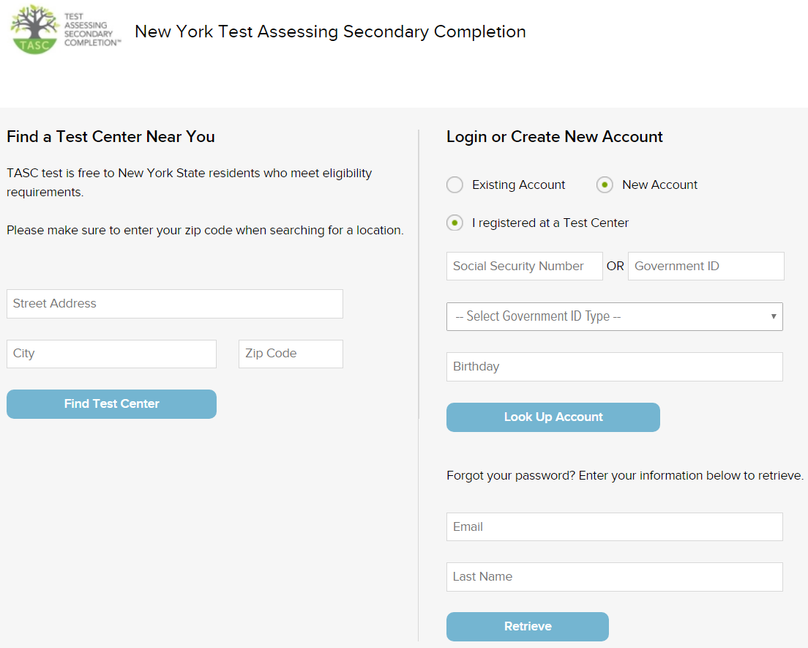

Slide 24
