Slide 1
New Teacher Orientation
How to Effectively Teach Adults

Slide 2
Adult Learning
What are adult student reasons for being in school?
Fulfill a dream
Get a job or promotion
Complete a resolution
Change careers
???????

Slide 3
Adult Learner Demographics
The majority of adults do not learn for the sheer pleasure of learning
Adults learn in order to cope with change in their lives
Every adult who learns because of a transition to a specific event that triggered the transition, and thus, learning
Trigger events occur unevenly in several arenas of adult life

Slide 4
How Do Adults Learn?
Adults seek greater involvement in decisions involving their education
The maturity level of adults indicates that they can accomplish more learning in less time
Adults place great value in education that offers convenience
Adults prefer goal directed learning orientations
Adults are looking for the acquisition of useful and relevant knowledge

Slide 5
Teaching vs. Learning
Is Teaching the purpose of education or is learning the purpose of education?
What is the difference?

Slide 6
Group Learning
Group Learning should be an integral part of the educational experience
Scenarios
Panel discussions
Problem solving
Learning games
Debates

Slide 7
Group Interaction
Key advantages of the group interaction include the following:
Students gain knowledge and experience from each other
A real-world working environment is simulated
Individual strengths and weaknesses are blended
A sharing of teaching and learning responsibilities is facilitated
Self-confidence and self-esteem are increased
Leadership and participatory skills are developed
Interpersonal communication skills are strengthened
Achievement of a higher level of quality and performance in project assignments is possible; and
Decision-making skills are developed.

Slide 8
Selected Strategies for Successful Instruction
Principles of Adult Learning.
Active Learning.
Instructional Strategies.
Notes:
Selected Strategies for Successful Trainings
Principles of Adult Learning.
Active Learning.
Instructional Strategies.

Slide 9
Principles of Adult Learning
Are autonomous and self-directed.
Have a foundation of life experiences and knowledge.
Are goal-oriented.
Are relevancy-oriented.
Are practical.
Need to be shown respect.
Notes:
Adult Learners . . .
Are autonomous and self-directed.
Have a foundation of life experiences and knowledge.
Are goal-oriented.
Are relevancy-oriented.
Are practical.
Need to be shown respect.

Slide 10
For each principle, there are implications for you, the instructor.
We should base our lessons on these principles.
Notes:
For each characteristic, there are implications for you, the trainer.

Slide 11
1. Adult learners are autonomous and self-directed.
Implications:
Involve participants.
Serve as facilitator.
Determine interests of learners.
Notes:
• Actively involve participants.
• Serve as their facilitator, rather than teacher.
• Find out what the participants want to learn before designing the training.

Slide 12
2. Adult learners have a foundation of life experiences and knowledge.
Implications:
Recognize expertise of participants.
Encourage participants to share their experiences and knowledge.
Notes:
• Recognize the value of experiences and knowledge participants bring to the training.
• Encourage participants to draw on their experiences and knowledge related to the topic.

Slide 13
3. Adult learners are goal-oriented.
Implications:
Be organized.
Have clear objectives.
Notes:
• Be organized.
• Have clearly defined goals, objectives, and agenda for the training.
• Early in the training, show participants how it will help them achieve their goals.

Slide 14
4. Adult learners are relevancy-oriented.
Implication:
Explain how learning objectives relate to class activities.
Notes:
Make sure participants see the relevance of the training, as well as individual activities and topics. (This relates to having clearly defined objectives that are stated early in the training.)

Slide 15
5. Adult learners are practical.
Implication:
Show relevance of class to earning their diploma.
Notes:
Tell participants explicitly how the training and individual activities will be useful to them on the job.

Slide 16
6. Adult learners need to be respected.
Implications:
Acknowledge the wealth of knowledge and experiences the participants bring to the training.
Treat the participants as equals rather than subordinates.
Notes:
Make sure to recognize participants’ knowledge, and treat them like equals rather than subordinates.

Slide 17
Active Learning
Learning is not a spectator sport.
The more actively engaged the learner is, the more learning takes place.
Different instructional methodologies have greater rates of retention.
Notes:
Implement active learning strategies in your trainings. The more actively engaged the learners are, the more learning takes place. Keep in mind that different instructional methods have greater rates of retention.

Slide 18
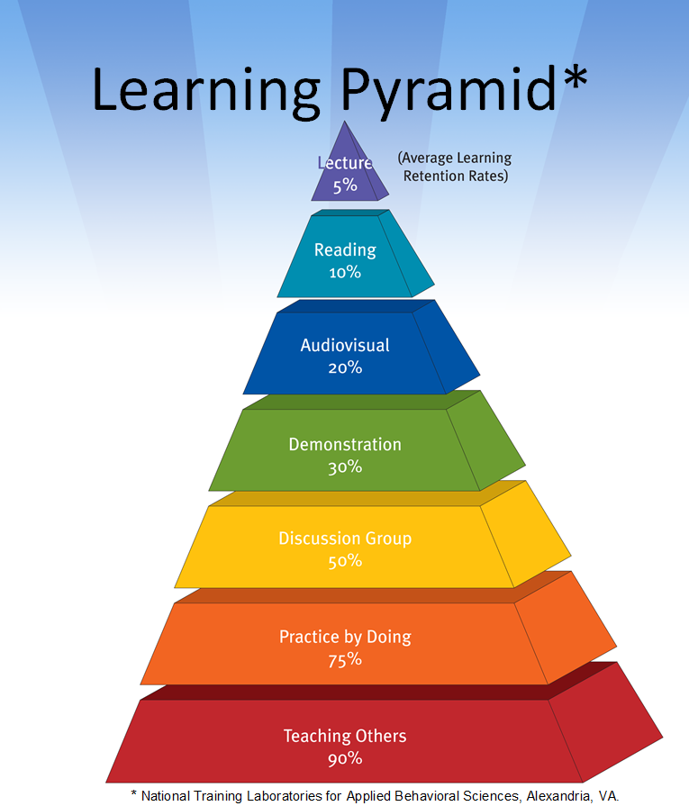
Notes:
Ask: How many of you learn best through lecture?
This pyramid demonstrates the proportion of people who learn best from selected instructional methodologies. Most of us learn best when we’re actively involved in the learning process (discussion groups, practice, teaching others).

Slide 19
Instructional Strategies
Quiz.
Games.
Role-playing.
Brainstorming.
Group problem-solving.
Lecture.
Notes:
There are several strategies you might want to consider depending on your audience and the purpose of your training. Some of the strategies are particularly relevant for food-safe schools. For example, role-playing could be incorporated by having participants practice talking to a teacher, administrator, or someone else about a particular problem that’s occurring. Several of these strategies are included in the activities in this training manual.

Slide 20
Summary
Apply principles of adult learning theory.
Make learning active.
Use strategies modeled in today’s orientation.
Notes:
Regardless of whom you are training, you will need to follow the principles of adult learning theory and active learning. Portions of this training have provided examples of some active learning strategies you might want to include in your own trainings.

